Slide 1
Model Presentation
March 23rd
AI Survey Team

Slide 2
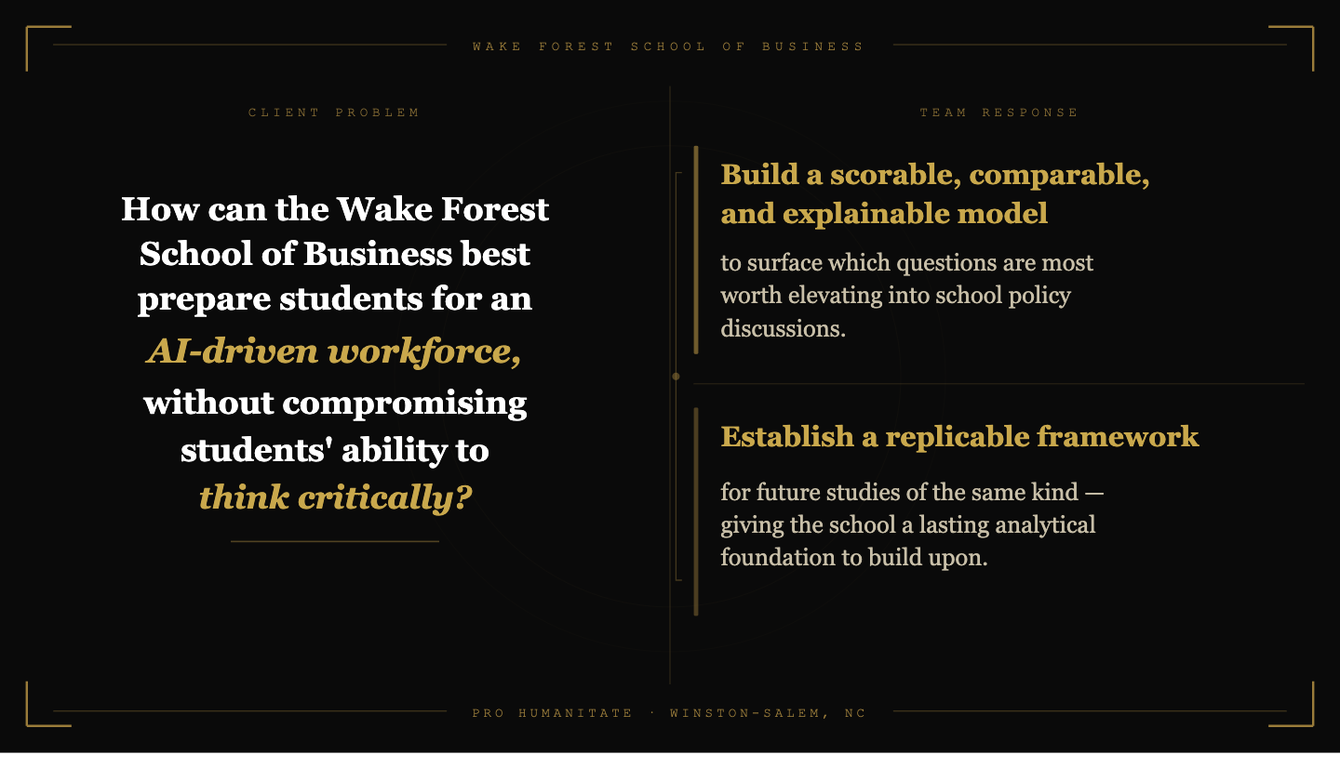
Modeling Student AI Attitudes
Notes:
bg debrief, and our approach (30s) To recap - data collected, AI policy
Client need - translated to our approach Other than building the model, the other critical underlying idea imbedded in our model is to establish a replicable framework

Slide 3
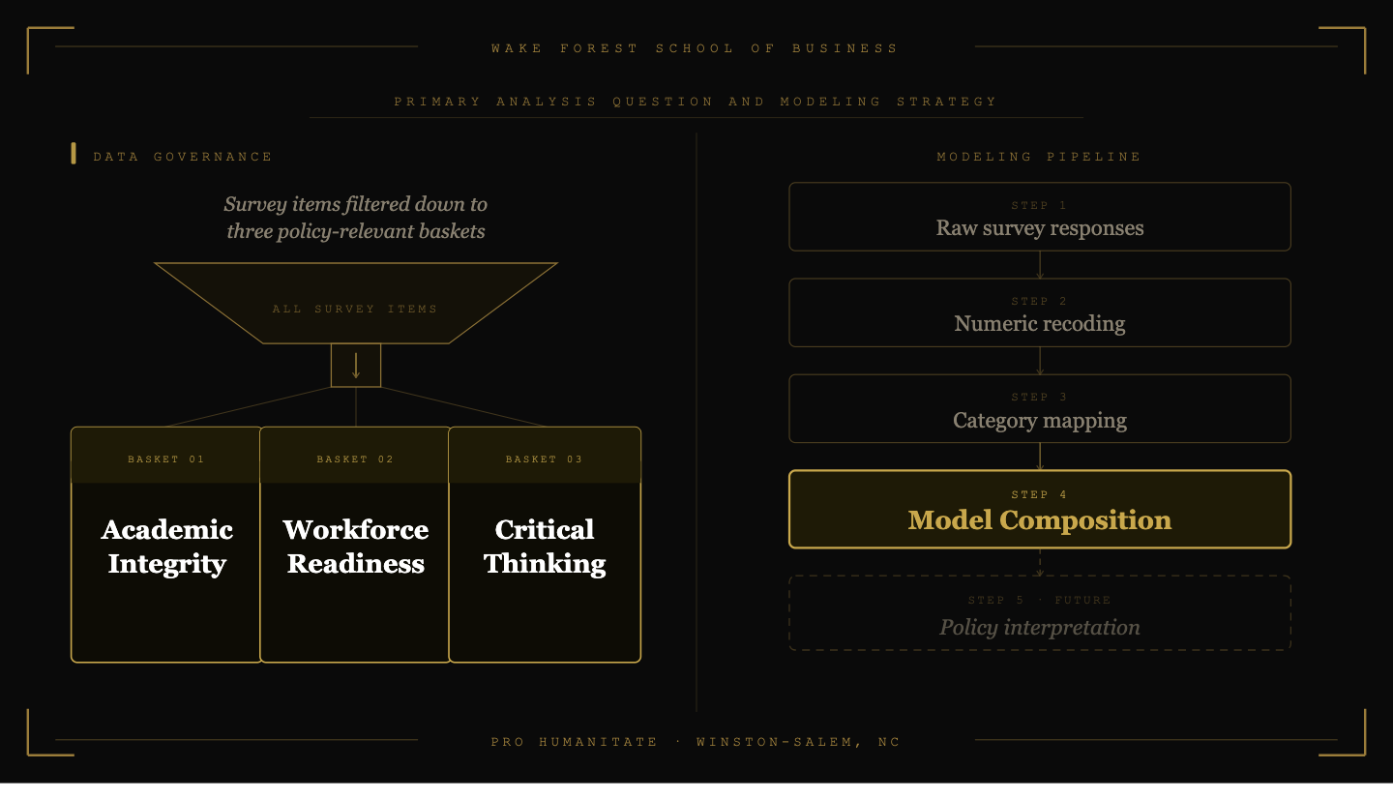
Notes:
what we did to set up the model (~40s)

Slide 4
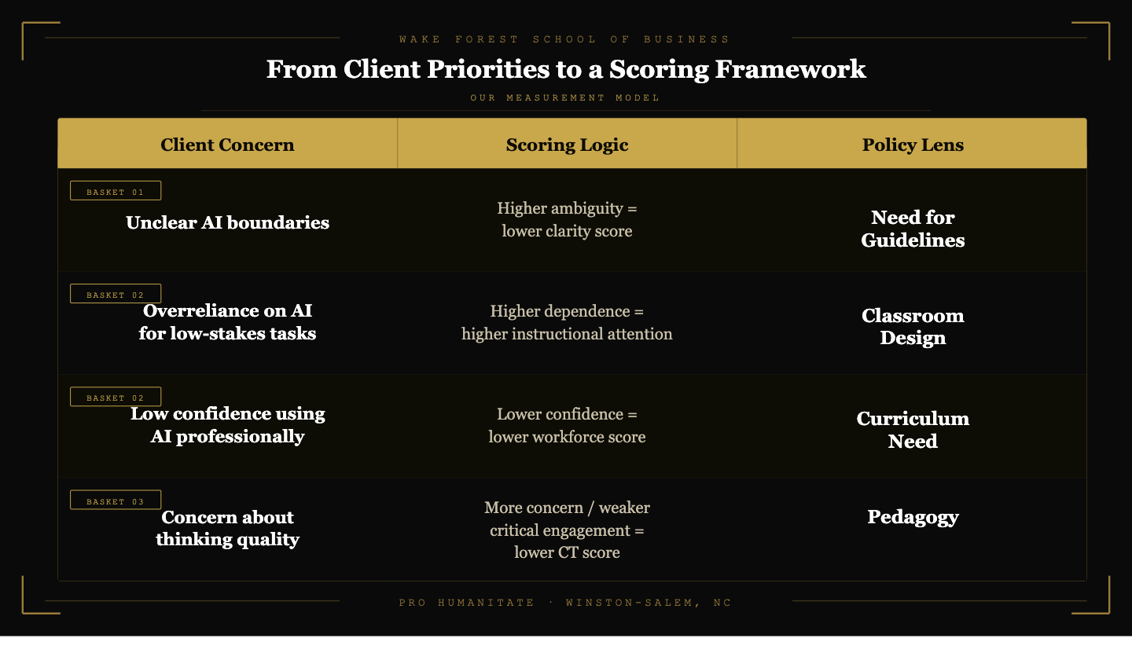
Notes:
goals, client report priorities (~40s)

Slide 5
⬡
⬡
⬡
⬡
⬡
⬡
Student-Reported Attitudes
⬡
⬡
⬡
⬡
⬡
Toward Generative AI
⬡
⬡
⬡
Using Likert Scale Measures
⬡
⬡
⬡
Business School Students · n = 349
Academic Integrity
Critical Thinking
Workforce Readiness
⬡
⬡
⬡
⬡
⬡
Notes:
This section presents findings from the Likert scale survey questions, which 349 business school students answered, examining their self-reported attitudes toward Generative AI across three domains: academic integrity, critical thinking, and workforce readiness.
It is important to note responses are self-reported, which introduces potential bias such as students answering in ways they perceive as socially acceptable rather than fully accurate. with that in mind, we interpret the results as indicative of general trends in student behavior.

Slide 6

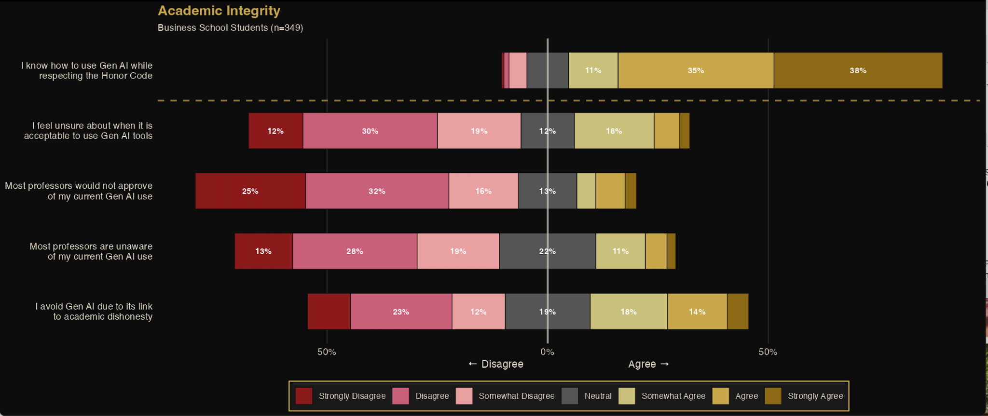
Notes:
This slide presents student-reported attitudes toward Gen AI in the context of academic integrity, surveyed across five items.
The standout finding is that a strong majority of students report knowing how to use Gen AI while respecting the Honor Code, with roughly 73% agreeing or strongly agreeing. This suggests a notable degree of self-reported confidence around ethical use
At the same time, uncertainty about when it is acceptable to use Gen AI tools is widespread. Just over 25% of students reported feeling unsure when it iz and approximately 35% report they avoid using it to prevent dishonesty, which points to a gap between self-assessed competence and clarity around institutional norms.
These patterns raise important questions about whether students are receiving sufficient, consistent guidance on acceptable use.

Slide 7
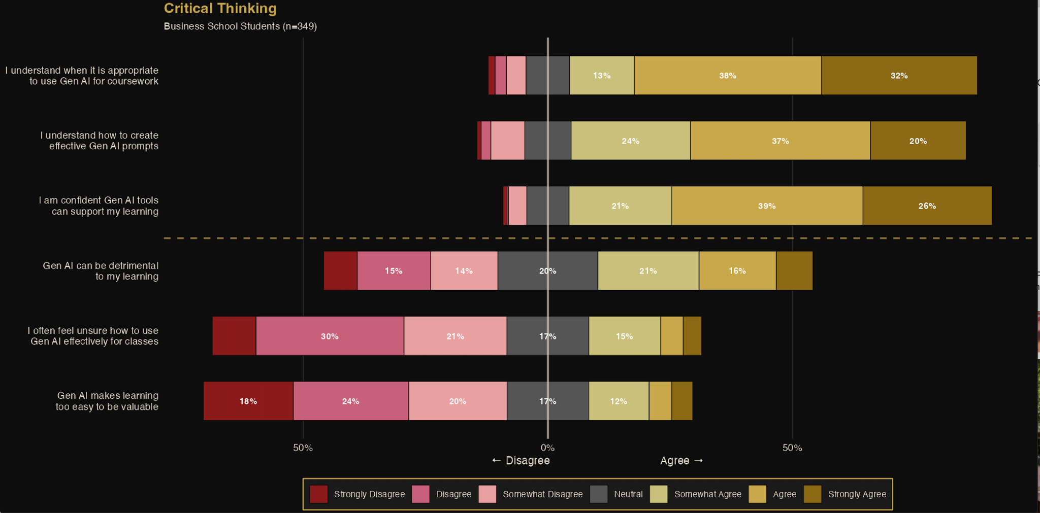
Notes:
This slide examines how students perceive Gen AI's effect on their critical thinking and learning processes across six items. Students demonstrate relatively high confidence in understanding when and how to use Gen AI appropriately. Approximately 70% agree they understand when it is appropriate for coursework, and a similar proportion feel confident in their prompting skills — suggesting Al literacy is fairly widespread in this sample.
However, A meaningful share of students agreed that Gen AI can be detrimental to their learning
students appear to see Gen AI as a useful tool, but many are still working out how to engage with it in ways that preserve the integrity of their own learning.

Slide 8
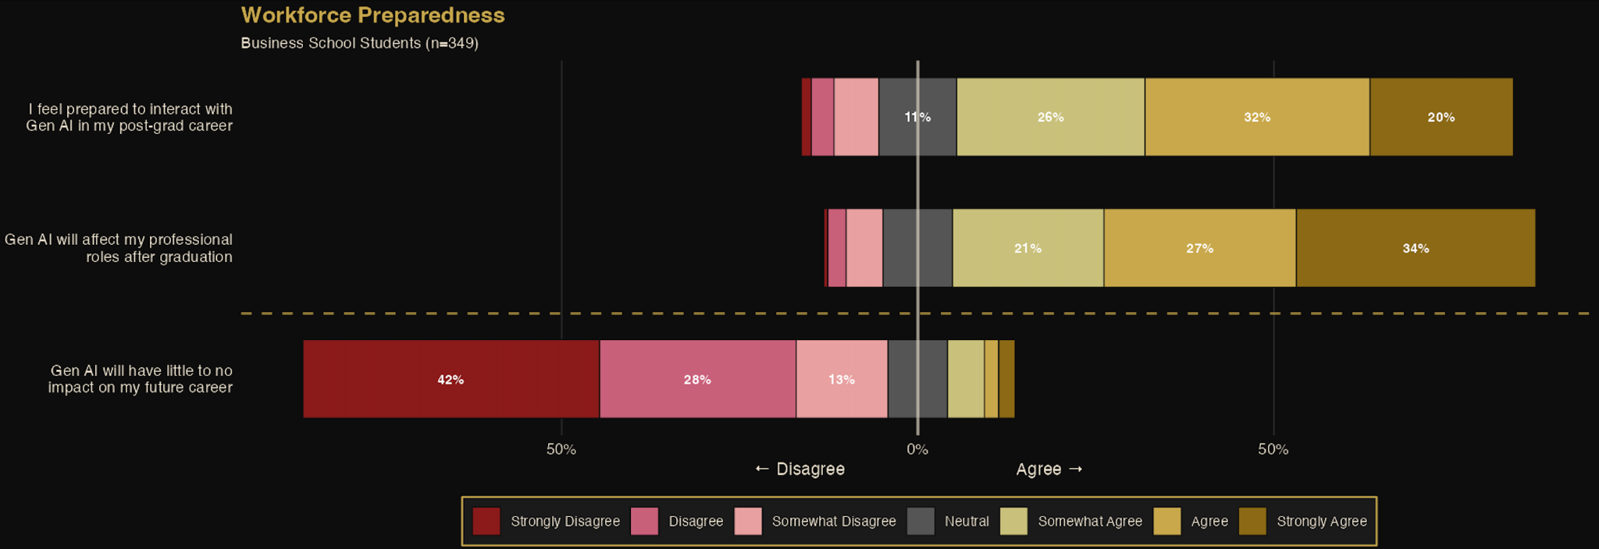
Notes:
This final slide presents student attitudes toward Gen AI and their post-graduation professional readiness, assessed across three items.
Overall, these items suggest that business school students are aware of Gen AI’s role in their future, and they largely feel prepared to meet it.
these three domains reveal collectively is a student population that is largely confident in their Gen AI literacy, but operating in an environment where institutional norms and faculty expectations not yet fully caught up.

Slide 9
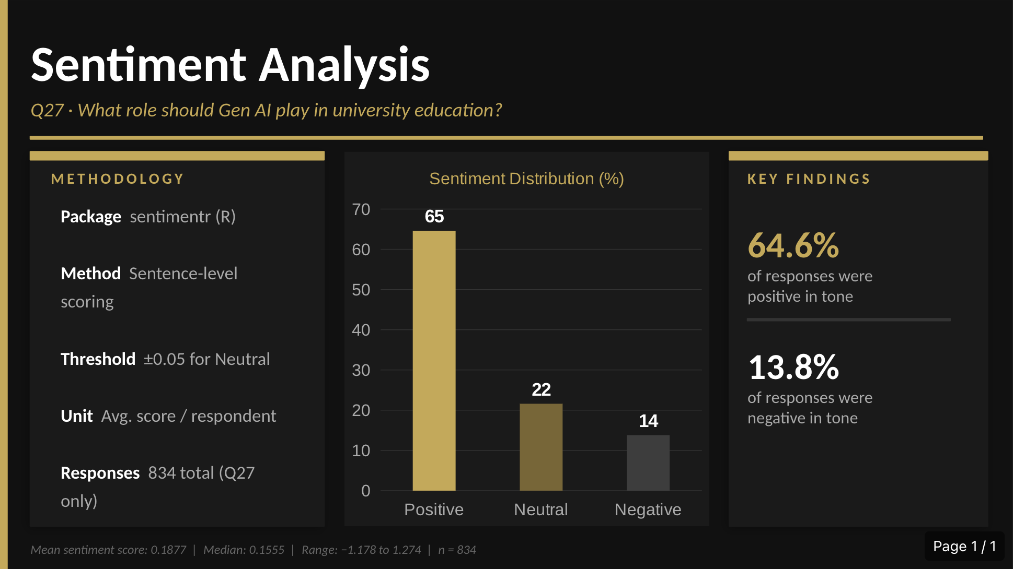

Sentiment Analysis
Notes:
For our sentiment analysis, we decided to use RStudio’s sentimentr library to analyze the open ended questions on the survey.
Q27: “What role do you think AI should play in higher education”
Positive example: “A way of quickly bringing up potential sources, or help with brainstorming, proofreading, and finding synonyms”
Negative example: “None, I think it should be banned completely”
Notes: redo with respect to business school students for SA, look at word cloud, and come up with recommendations

Slide 10
Thank You!

